Slide 1

NAVISTAR / MWM
PRODUCT LINE UP
OCTOBER 2010

Slide 2
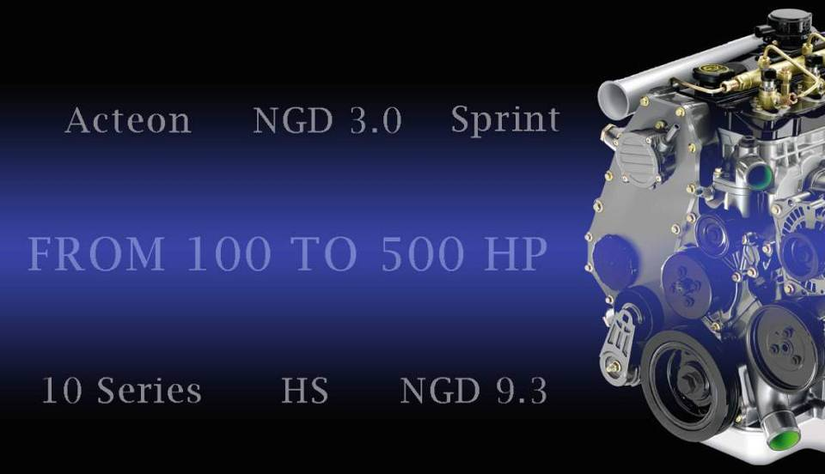
VEHICULAR ENGINES
GENSET ENGINES

Slide 3

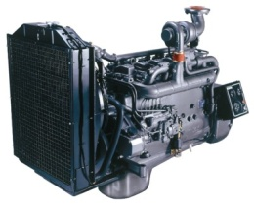
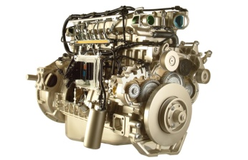
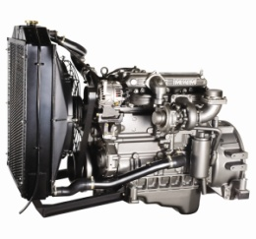
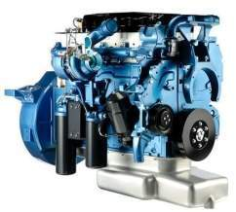
STATIONARY LINE UP
229 Series - 3.0/4.0/6.0
Standby Power (KVA - 50Hz)
31 M
43 M
12 Series - 4.8
68 M
10 Series - 4.3/6.5
70 M
88 M
91 M
82 M
97 M
100 E
12 Series - 7.2
125 M
125 E
138 M
150 M
147 E
154 M
160 E
12 Series - 7.2
176 M
180 E
200 E
NGD - 9.3
216 M
NGD - 9.3
275 E
No Emissioned
289 E
295 E
Tier 2/3
325 E
3

Slide 4
STATIONARY LINE UP
229 Series - 3.0/4.0/6.0
StandbyPower (KVA - 50Hz)
Under Development
31 M
43 M
12 Series - 4.8
68 M
10 Series - 4.3/6.5
70 M
Mechanical – SOP: Oct/10
Electronic – SOP: Dec/10
88 M
91 M
82 M
97 M
100 E
12 Series - 7.2
125 M
125 E
138 M
150 M
147 E
154 M
160 E
12 Series - 7.2
176 M
I6
180 E
200 E
NGD 9.3
216 M
NGD - 9.3
275 E
No Emissioned
289 E
SOP:
Q1 2011
(BASIC ENGINE)
SOP:
Q1 2011
(BASIC ENGINE)
Tier 2/3
295 E
325 E
4

Slide 5
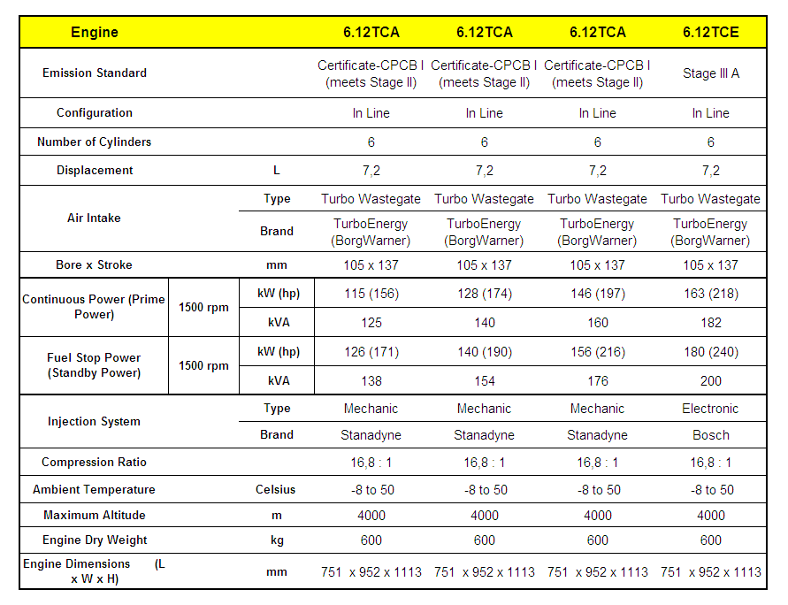
12 SERIES – TECHNICAL INFORMATION

Slide 6
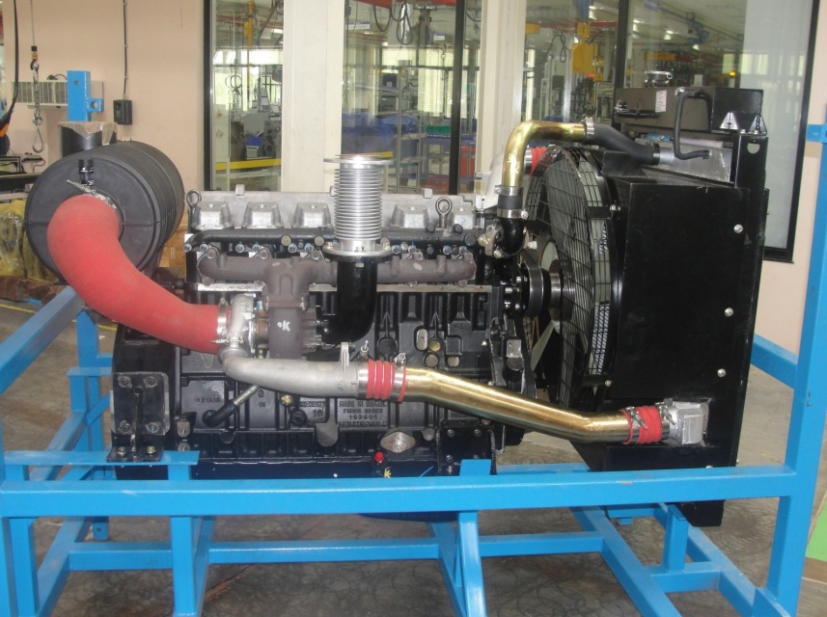
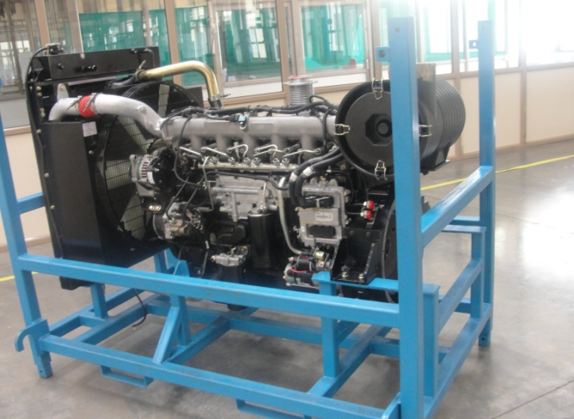
12 SERIES
Prototype Engines
DRESS-UP
Alternator
Starter
Cooling System
Air Filter
Silencer
Without Control Panel
Mechanical Version (160 kVA)
Electronic Version (180 kVA)
6
6
Notes:
We count on the best Dealers and Service Network for diesel engines in the region, with almost 600 points to support our customers.

Slide 7
VEHICULAR ENGINES
INDUSTRIAL ENGINES

Slide 8




INDUSTRIAL LINE UP
229 Series / MS Series - 3.0/4.0/6.0/3.9/4.1
PRIME Power (KW)
37 M
49 M
74 M
10 Series - 4.3
104 M
10 Series - 4.3/6.5
86 M
58 M
94 M
53 M
120 M
143 M
12 Series - 7.2
194 M
NGD - 9.3
No Emissioned
233 E
Tier 2
8

Slide 9
VEHICULAR ENGINES
MARINE ENGINES
9

Slide 10
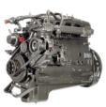



MARINE LINE UP
PRODUCT RANGE (TIER 0)
290hp
240hp
120-200hp
80hp
56hp
229 Series
3M
229 Series
4M
229 Series
6M
229 Series
6.5M
12 Series
7.2M
I3 – 2.9L
I4 – 3.9L
I6 – 5.9L
I6 6.5L
I6 7.2L
10
Notes:
10

Slide 11
VEHICULAR ENGINES
AGRICULTURAL ENGINES

Slide 12


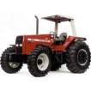


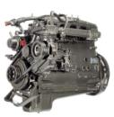
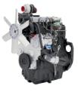

AGRICULTURAL LINE UP
Current Tier 0
Tier 2/3 Plan
125-160hp
Under development
83-110hp
83-105hp
72hp
102hp
62hp
72hp
299 Series
3
229 Series
4
229 Series
6
MS Series
3.9
MS Series
4.1
MS Series
4.1
MS Series
4.1
I3 – 2.9L
I4 – 3.9L
I6 – 5.9L
I4 – 3.9L
I4 – 4.1L
I4 – 4.1L
I4 – 4.1L
Notes:
12

Slide 13
VEHICULAR ENGINES
AUTOMOTIVE ENGINES

Slide 14

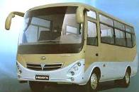
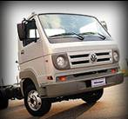
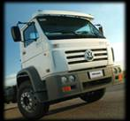
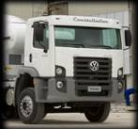
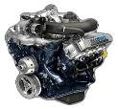
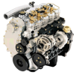


EURO II and III ENGINES
115hp
392Nm
172hp
700Nm
256hp
900Nm
158hp
450Nm
161hp
380Nm
141hp
400Nm
NGD
3.0HS
Sprint
3.0H
Sprint
3.2H
10 Series
4.3H
10 Series
6.5H
12 Series
7.2H
I4 3.0L
I4 3.0L
I4 3.2L
I4 4.3L
I6 6.5L
I6 7.2L

Slide 15
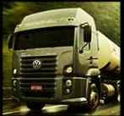
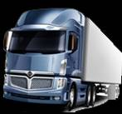

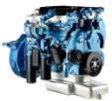
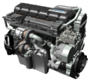
EURO IV and V ENGINES
367hp
1600Nm
550hp
2510Nm
330hp
1300Nm
160hp
500Nm
217hp
850Nm
163hp
380Nm
NGD
3.0HS
Sprint
3.2H
12 Series
4.8H
12 Series
7.2H
NGD
9.3H
Big Bore
15H
I4 3.0L
I4 3.2L
I4 4.8L
I6 7.2L
I6 9.3L
I6 15L

